Slide 1
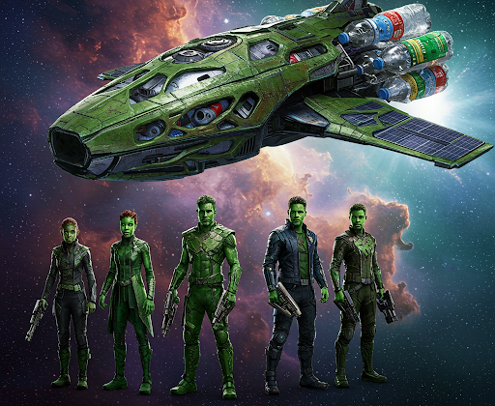
Garbage:
A Universal Problem
Team 6 - The Green Guardians
Asa Adomatis | Vikram Borra | Katie Craig Mary Pulley | Sophak So
TA - Rimi Sharma

Slide 2
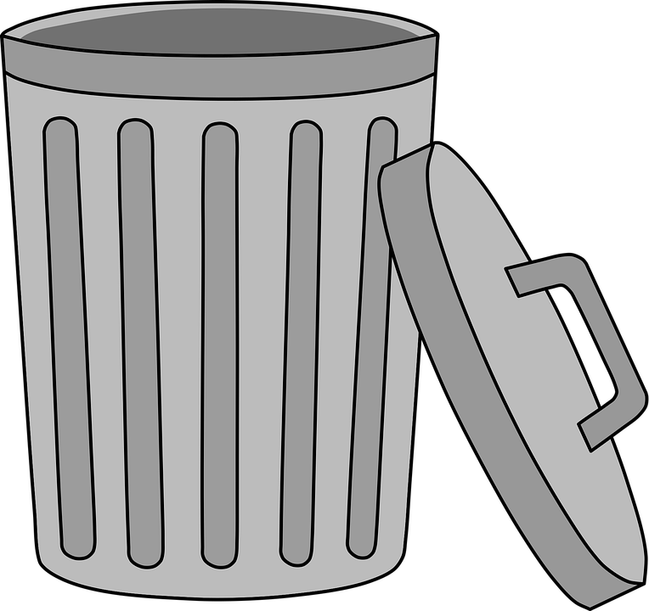
Trash is becoming a global problem
We explored how machine learning can reduce the amount of waste contributing to this global issue.
Our goal was to create a tool that classifies household items from an image and reduces the amount of waste that communities contribute to their local landfill.
Notes:
According to the EPA, “Pay-as-you-throw (PAYT) communities are a different way of paying for waste collection and disposal services. In some communities, it works on a per-container basis: households are charged for each bag or can of waste they generate….the system motivates people to recycle more and to think about ways to generate less waste in the first place.” We explored how to help consumers quickly decide whether an item is recyclable or not.

Slide 3

Why Image Classification?
The problem we are solving is: Provide a quick way for customers to reduce their waste by using a picture to classify recyclable items vs non-recyclable items.
We will use image classification for this to introduce a quick, simple way to give customers a way to decide whether an object is recyclable or not based on the type of item in 1 of 8 classes: battery, cardboard, clothes, glass, metal, paper, plastic, and trash.

Slide 4
Executive Summary
This project aims to classify images of garbage into 8 different categories (battery, cardboard, clothes, glass, metal, paper, plastic, & trash). This involves assigning a qualitative label (category) to each image, provided by a pre-categorized data set. We utilized a convolutional neural network for this multi-classification problem.
The model is trained to predict:
Probability of an image belonging to each category
Final prediction of the category with the highest probability.

Slide 5
Our Approach
Week 1
Week 2
Data Collection
Gather Garbage images with classification data
Ensure size and diversity of data
Data Pre-processing
Normalization
Resizing
Augmentation
Model Selection
Choose a Model Architecture:
Selected a convolutional neural network (CNN) architecture suitable for image classification
Model Training
Split the Dataset
Training
Optimization
Model testing
Evaluation
Deployment
Integrate into a front-end application

Slide 6
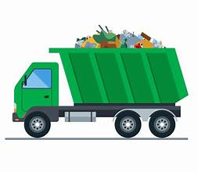
Data collection, clean up & exploration…
Utilized existing image data set of 15k images, pre-classified by type
Tested methods to handle size of importing images (pickle, gdown, etc)
Created CNN model of 3 convolution layers paired with 2 pooling layers

Slide 7
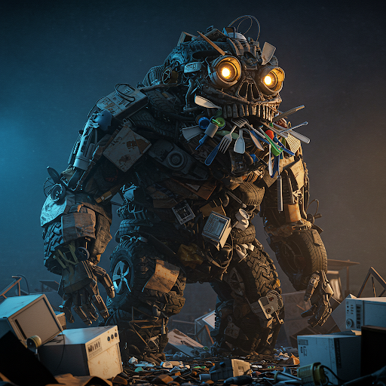
Technologies Used
pickle
GitHub
Google CoLab
numpy
Gemini
PIL
pandas
gdown
Gradio
sklearn
os
imblearn
kagglehub

Slide 8
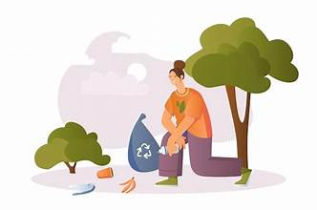
Barriers we encountered…
Memory
& Storage
Getting the right number of classes
Model layers
Notes:
GITLFS: Github large file storage was used due to the limited space on github for the free version. This helped us get our model to github before utilizing gdown
Right number of classes: Explored ways to limit dataset because Using CoLab - couldn’t use standard runtime and CPU and had to pay to get it running
Optimization: Limiting the number of classes & getting the right number of layers

Slide 9
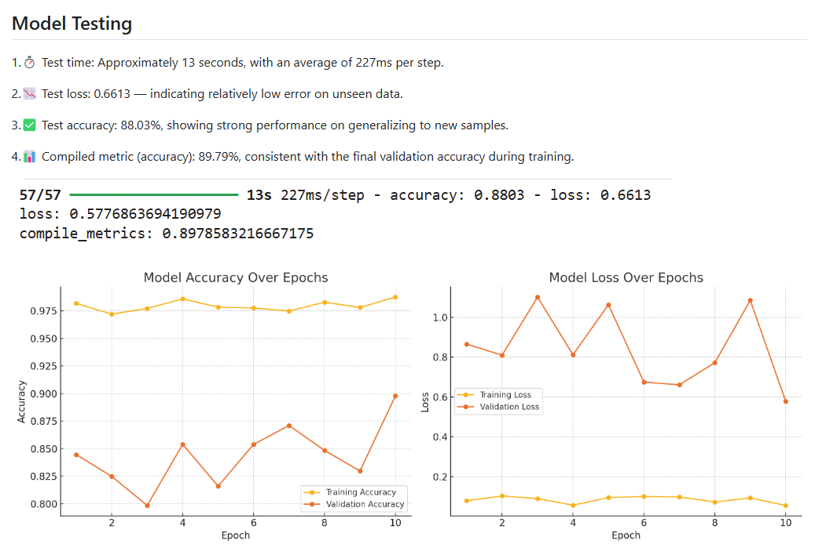
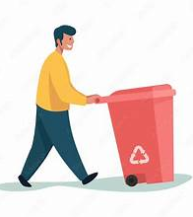
How we evaluated the trained model…

Slide 10
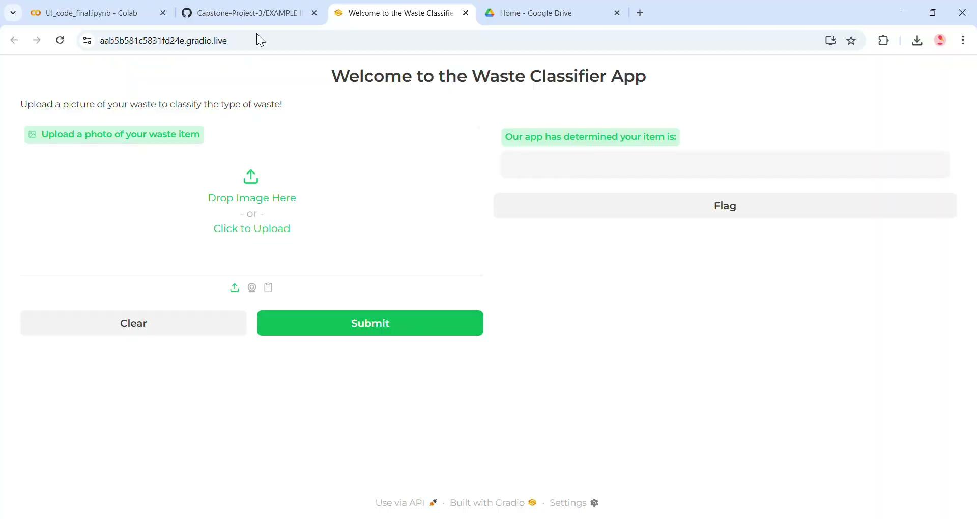

Slide 11
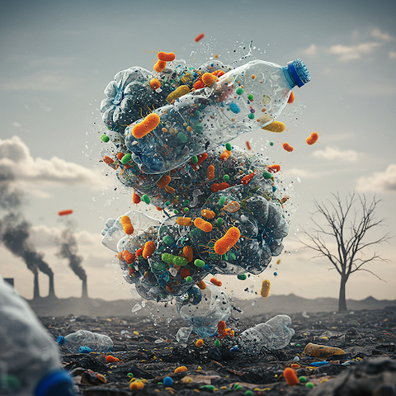
Results & Conclusions…
90%
Our image classification model was more
accurate than we expected and could handle untrained data.
1,500 lbs of waste per person
goes into a landfill annually
An app to tell the difference between recycling and trash can make a difference.

Slide 12
Next Steps
If we had more time…
Usability Testing
with real customers, including with educators
Use package like Optuna for tuning hyperparameters
Experimenting with additional models
Integrating with existing recycling programs

Slide 13
Sources
EPA website
Dataset
Programming
https://archive.epa.gov/wastes/conserve/tools/payt/web/html/public.html
https://www.kaggle.com/datasets/mostafaabla/garbage-classification/data
Google CoLab

Slide 14
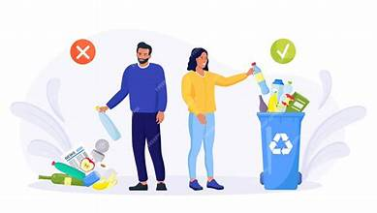
Questions & Appendix

Slide 15
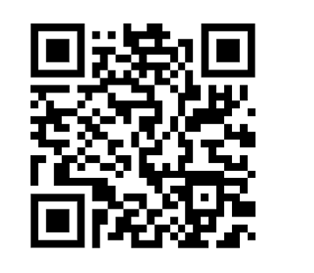
Link to our repository
Click here
to learn more

